Slide 1
Marketing Mix

Slide 2


Slide 3
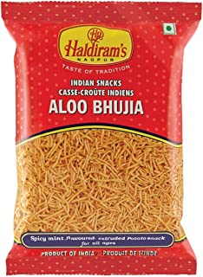
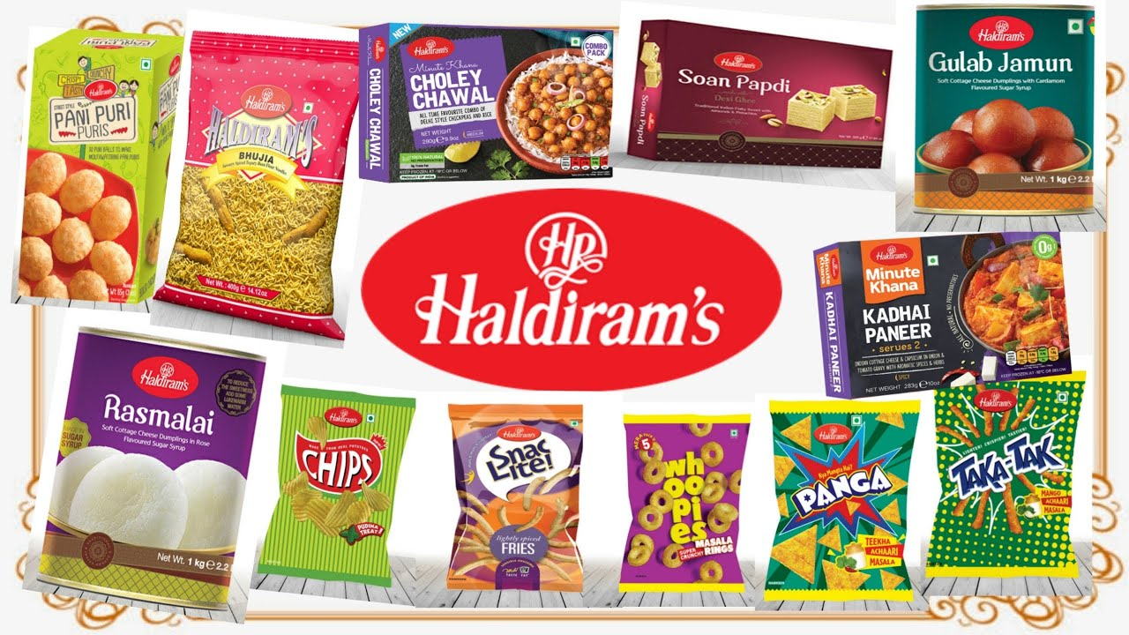
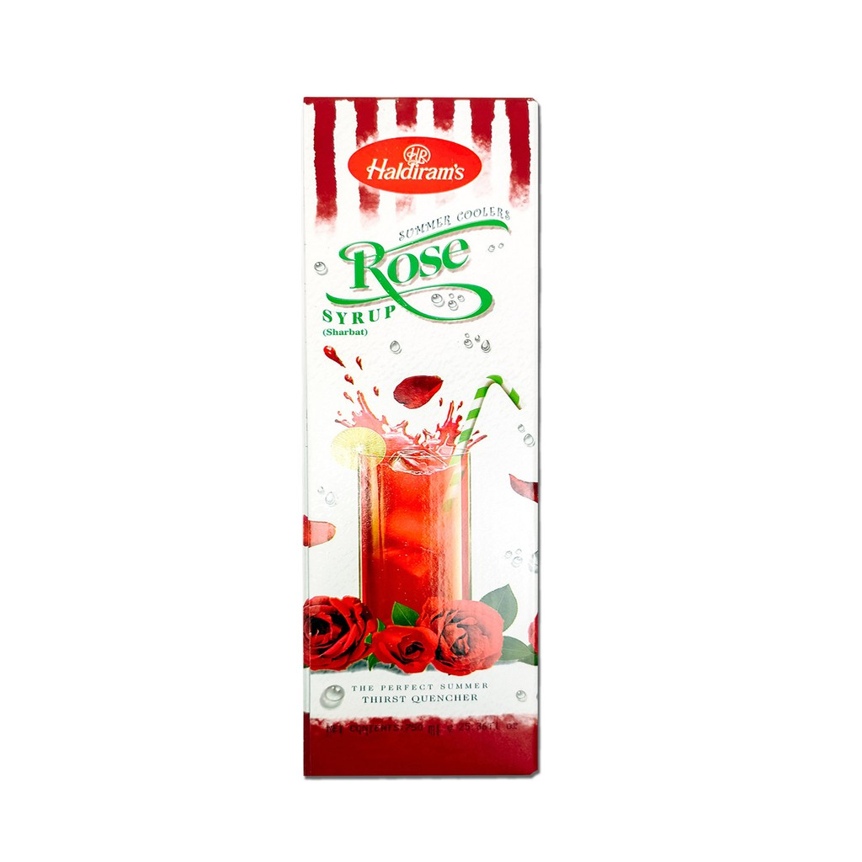

Slide 4
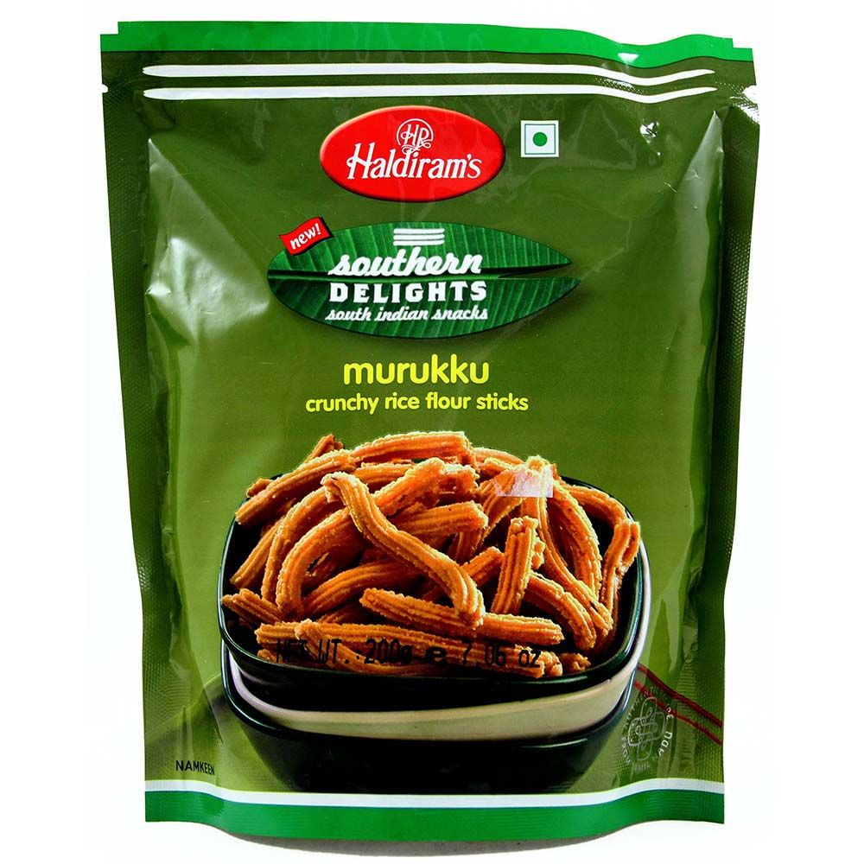
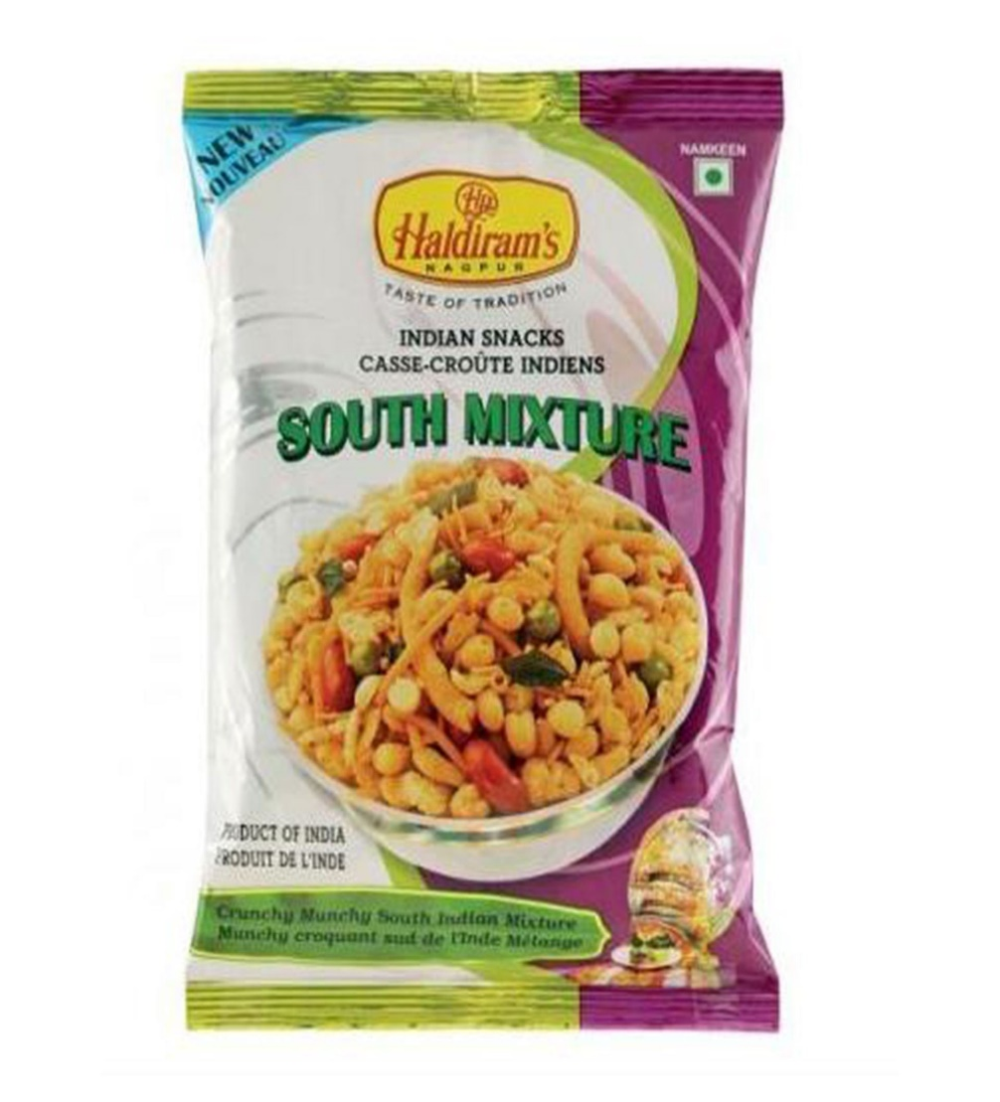

Slide 5
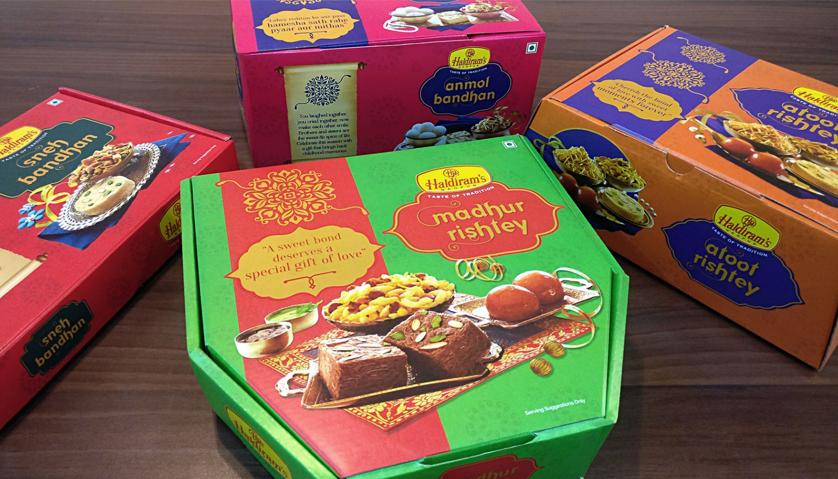

Slide 6

Rs 5
Family Pack
Rs 160

Slide 7
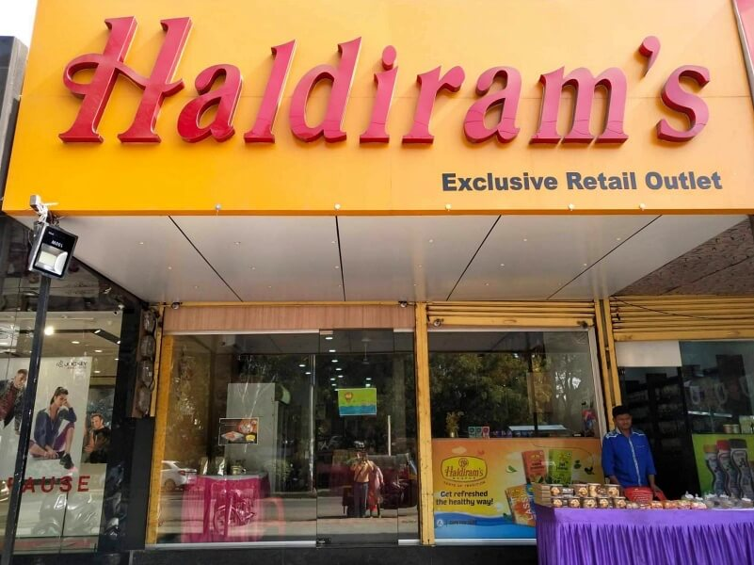

Slide 8
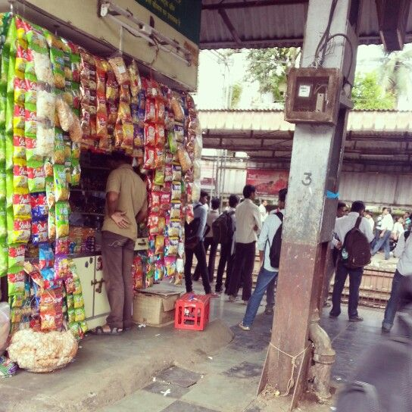

Slide 9
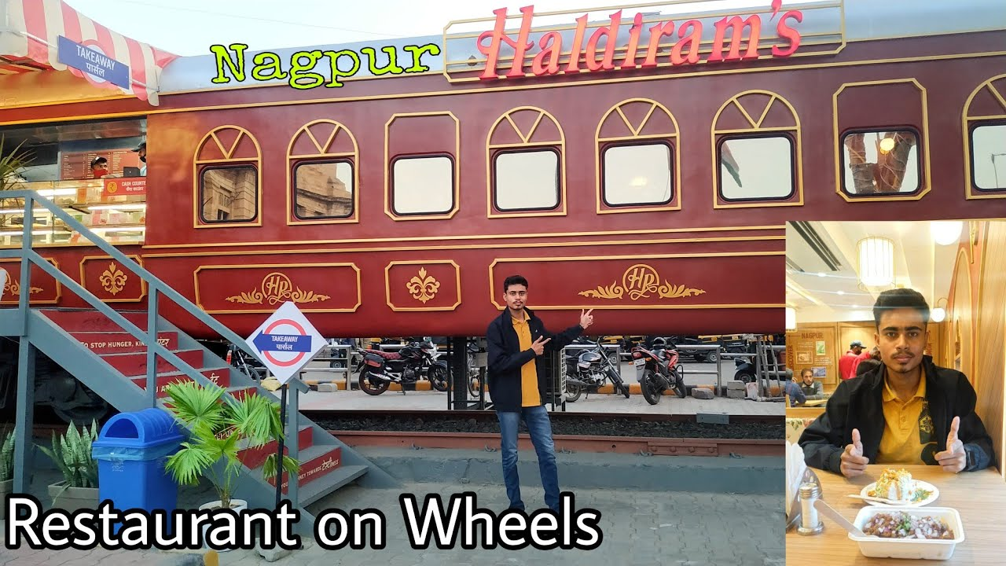

Slide 10
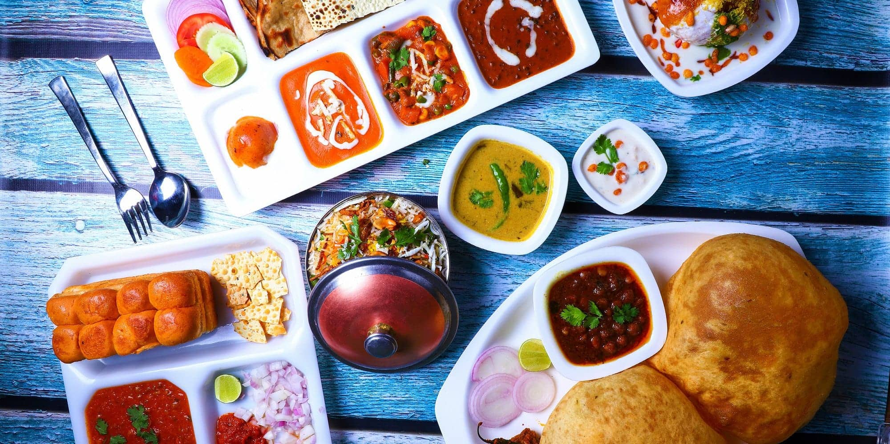

Slide 11
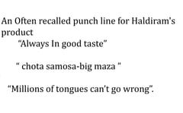

Slide 12
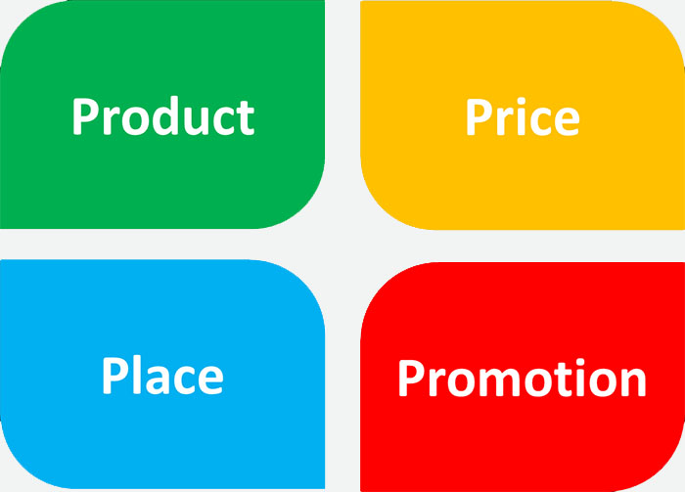

Slide 13
Product
Range includes
Namkeens- Different Flavours
Sweets
Sharbats
Bakery items
Dairy Products
Papads
Ice –creams
Promotion
Attractive Posters, Banners
Appealing masses
Punchline
Always in good Taste
The king of all chats
Six Months on shelf and six seconds in your mouth
Captions- Millions of Tongues cant go wrong
Print –Entire Range
Hoardings- High Traffic areas (Train/Bus Stations)
Poster-History of Haldiram’s
POP displays- special racks
Packaging
Impulse purchase
Attractive Color-Red
Nitrogen filled pouches
Shelf life Increased- 6 Months
Price
Competitive Price
Price consciousness nature of Customer
Small pack Rs 5
Different packs – Rs100, 60, 40, 20, 10, 5
Place
Exclusive Showrooms
Retail Outlets- Supermarkets, Sweet shops, Bakeries, Railway stations, Bus stations
Ecommerce
Giftstoindia.com

Slide 14
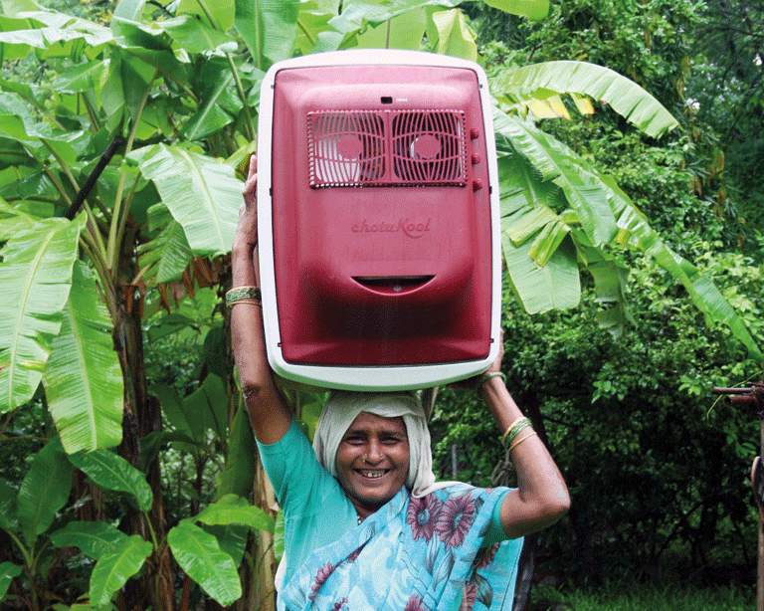
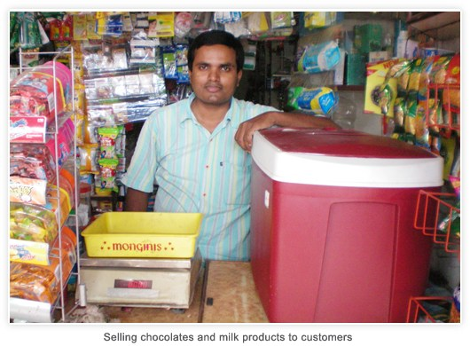

Slide 15
Chotukool A refrigerator for the rural India.
But Chotukool soon faced challenges in scaling up in smaller markets
.
While it was the cheapest refrigerator in India priced at `3,500 and `3,800.
it faced distribution and infrastructure challenges in rural areas.
It tied up with India Post and launched awareness campaigns, but these measures were not enough.

Slide 16
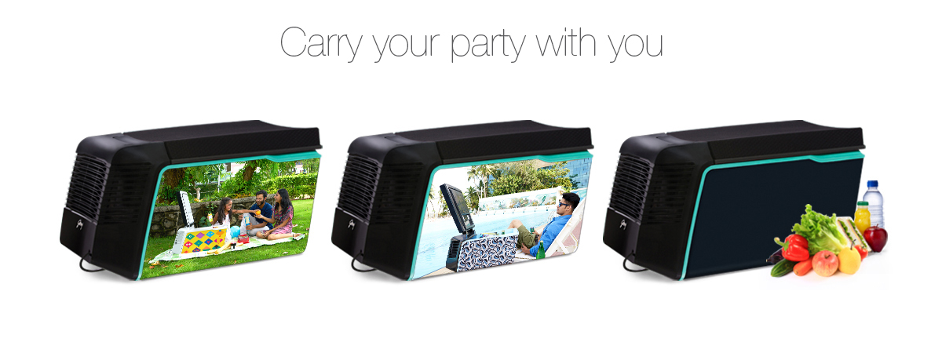
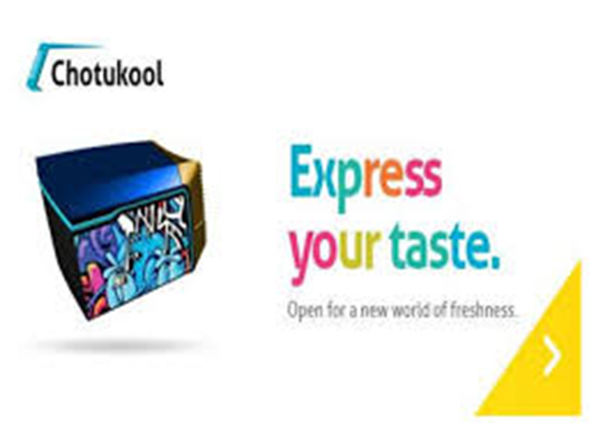
ChotuKool, India’s first mobile food and beverage cooler
Today it is a lifestyle product that people use in cars. Reinvented its shape and design, offering limited editions and tapping different sets of audience.

Slide 17
Marketing Mix
Marketing mix is the set of marketing tools that the ﬁrm uses to pursue its marketing objectives.
Inﬂuence the trade channels as well as the ﬁnal consumers.

Slide 18
Product
Features, Appearance
Price
How much customer has to pay
Promotion
How customers are informed about products
Place
Point where products are made available

Slide 19
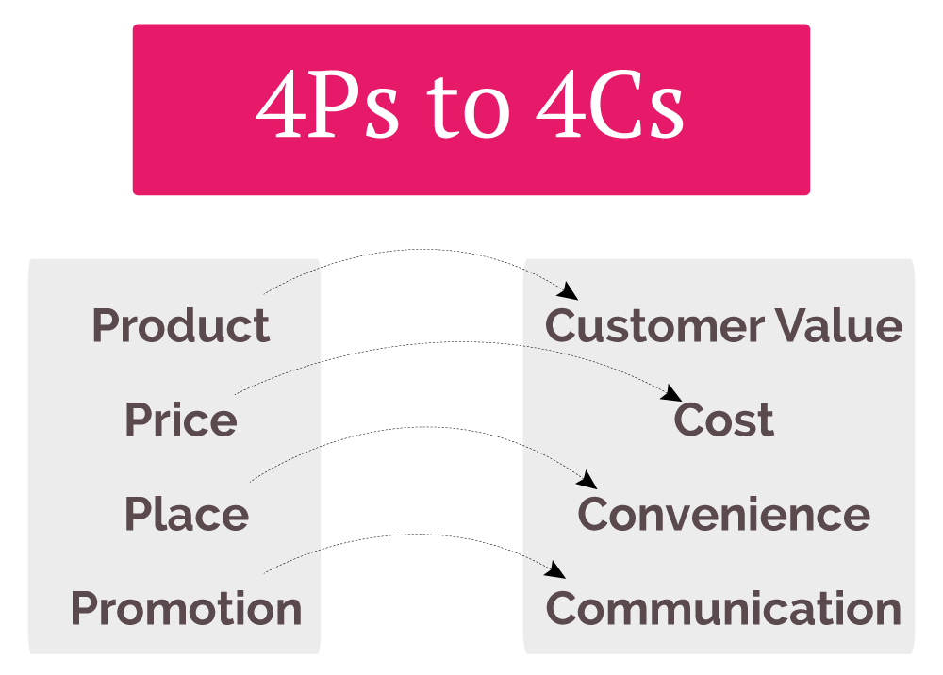

Slide 20
Coined Marketing Mix- James Culliton, Marketing Manager – Mixer of ingredients Popularized Marketing Mix- Neil H. Bordon 4Ps- Jerome Paul McCarthy 4Cs- Robert Lauterborn

Slide 21


Slide 22
135-year-old company's product portfolio - Chyawanprash, Pudin Hara, Hajmola etc. Getting Future Ready.
Those brands which are not seen as relevant to the newage consumer will be reengineered to meet that requirement.
Health- entire portfolio.
Chyawanprash A candy, bar, tablets or biscuits.
Younger talent- leadership roles. The average age of the marketing team is 35-36, down from 42.
Advertising, communication - change.

Slide 23
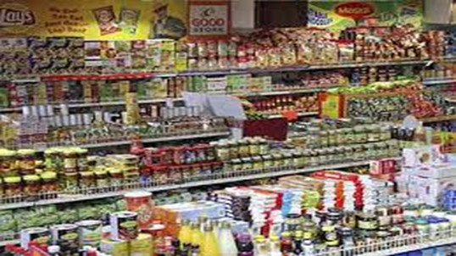
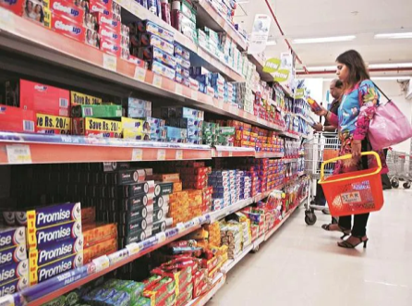
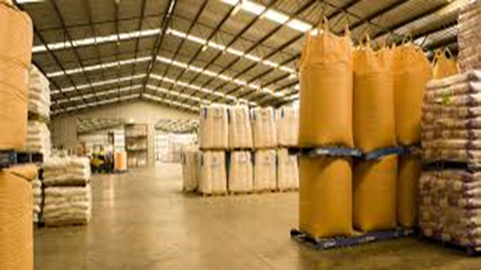
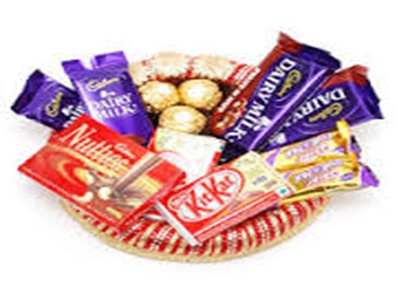
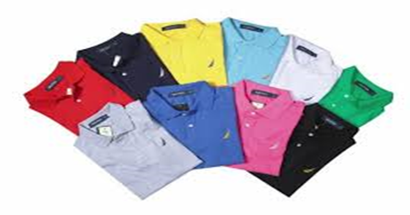

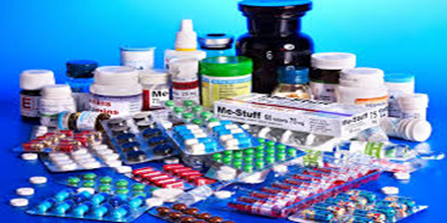



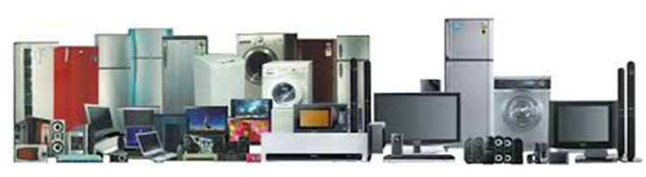

Slide 24
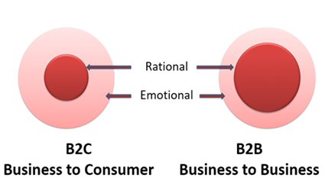
Classification
Consumer Goods
Convenience
Staples
Impulse
Emergency
Shopping
Specialty
Unsought
Durability and Tangibility Durable- Non Durable Goods- Services
Industrial Goods- Material and parts, Capital items, Supplies

Slide 25
A product is any offering that can satisfy a need or want

Slide 26
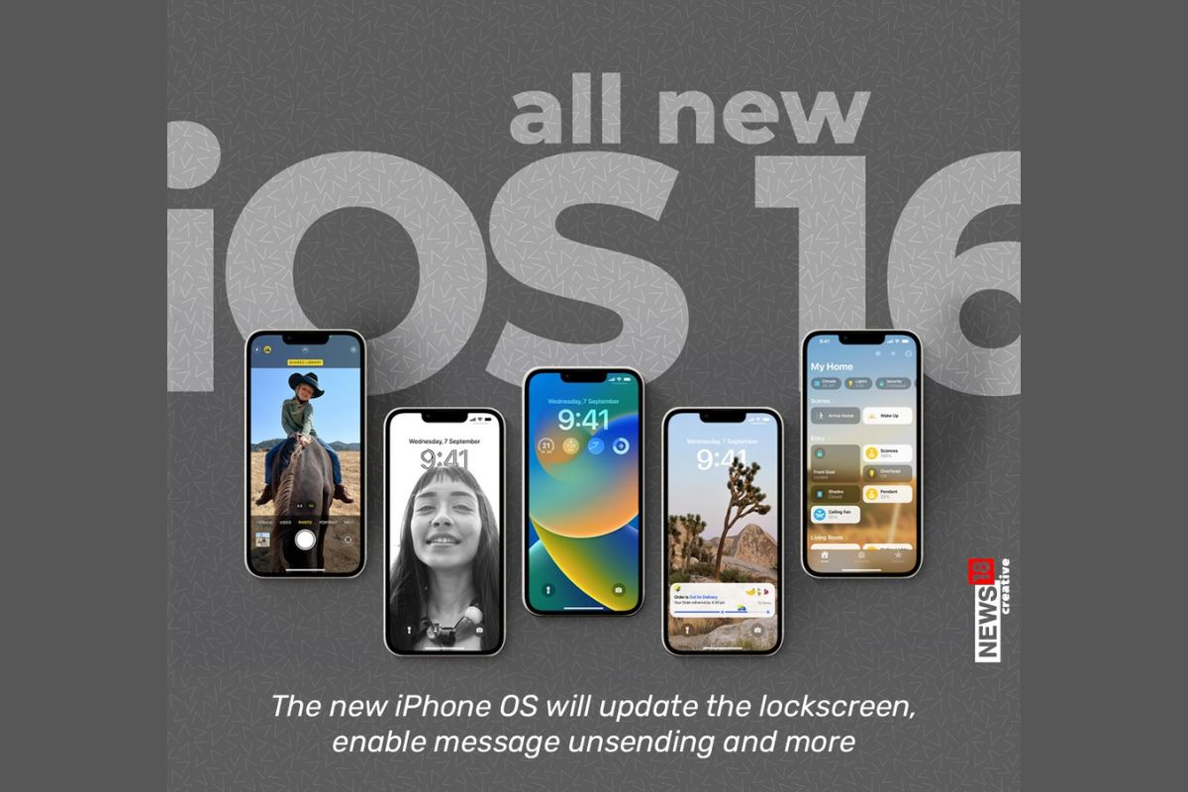
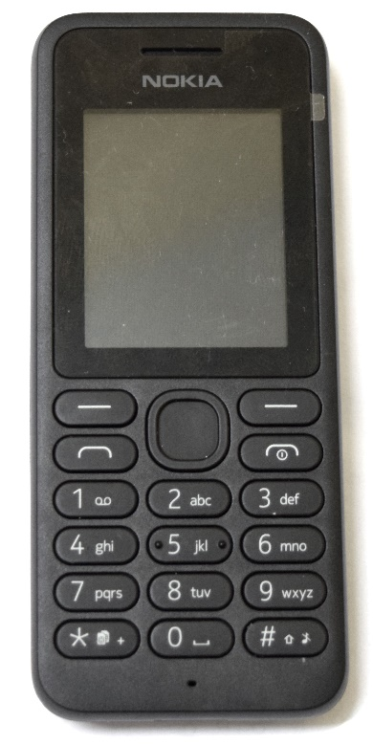

Slide 27


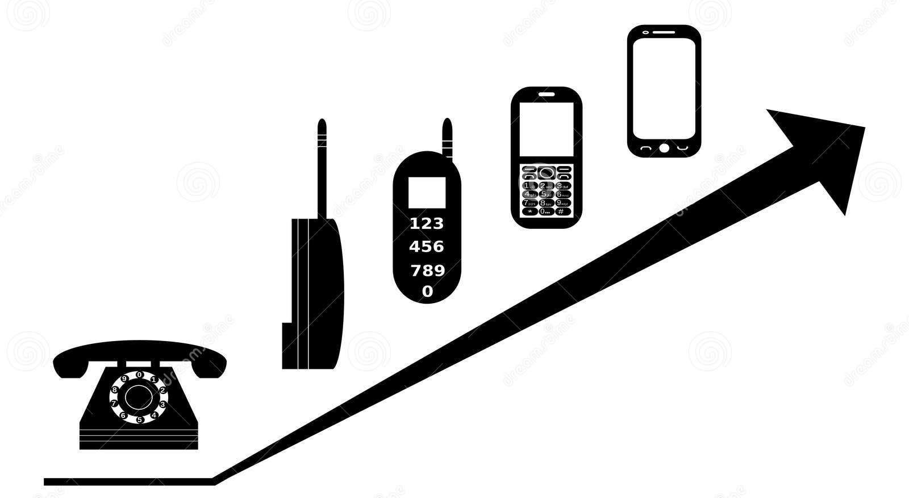

Slide 28
DEO Sweating Fragrance Fragrance variety Underarm Whitening Sensitive skin

Slide 29
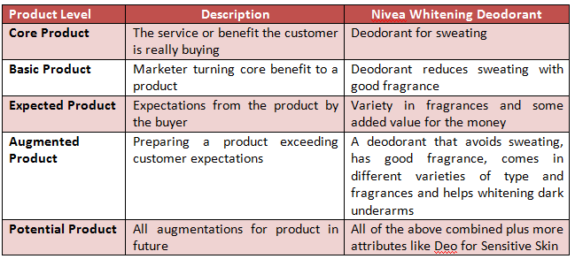
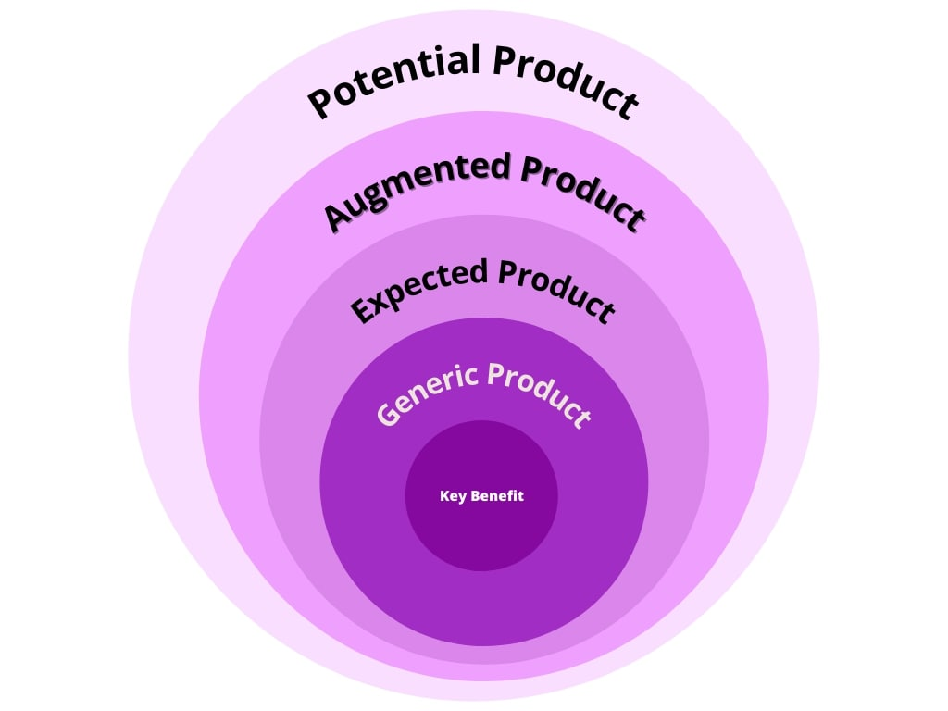
Product Levels
Core - Consumers’ fundamental needs to satisfy by consuming your product.
A generic/Basic product is a version of the product containing those attributes or characteristics necessary to function.
Expected - Every product has essential product features that buyers expect when they purchase it.
Augmented products are a cost-effective way to set your product apart from the competition, exceeds customer expectations.
Potential- In the future, products will undergo transformations and augmentations
Core Product

Slide 30

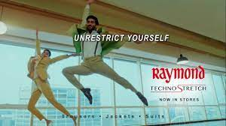
Readymade, International

Slide 31

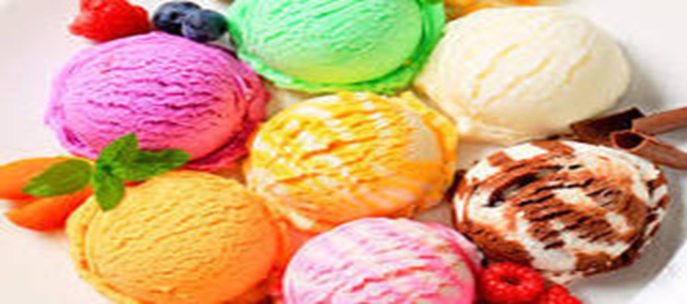
Three core ingredients to make ice cream: fruits, milk, and sugar. Selected difficult flavours like custard apple, to get famous in the fruit ice cream business. “Natural has fruit flavours no one has picked. They have got melon, jack fruit, gooseberry, mulberry, raspberry. Probably highest range of fruits ice cream in the world. Introduced ‘Prasadam’ category so that people know there’s no egg in this ice cream. This is perhaps the only ice cream brand in the world that invents one flavour every week. ‘Taste the Original' solved the problem of fake Natural parlours. Unlike any other ice cream, Natural is made of boiled milk which takes three times as long to get ready to be scooped up.

Slide 32
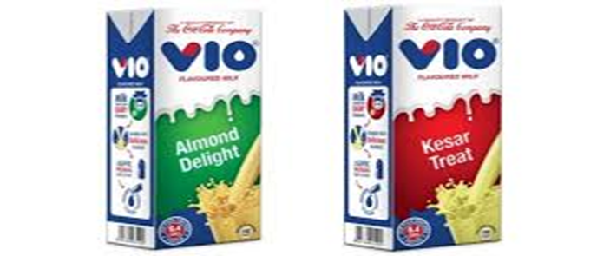
Coca-Cola fusion
Coca-Cola has launched Fuze Tea, a fruit-flavoured tea drink, Vio, a flavoured milk, and now, Fanta, that has 10 per cent juice in it.
This is an innovation following prime minister’s call to manufacturers to add at least two per cent juice in carbonated drinks to help the cause of farmers.

Slide 33
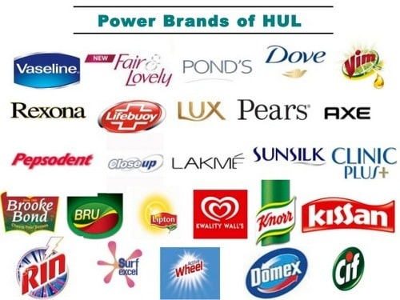

Slide 34
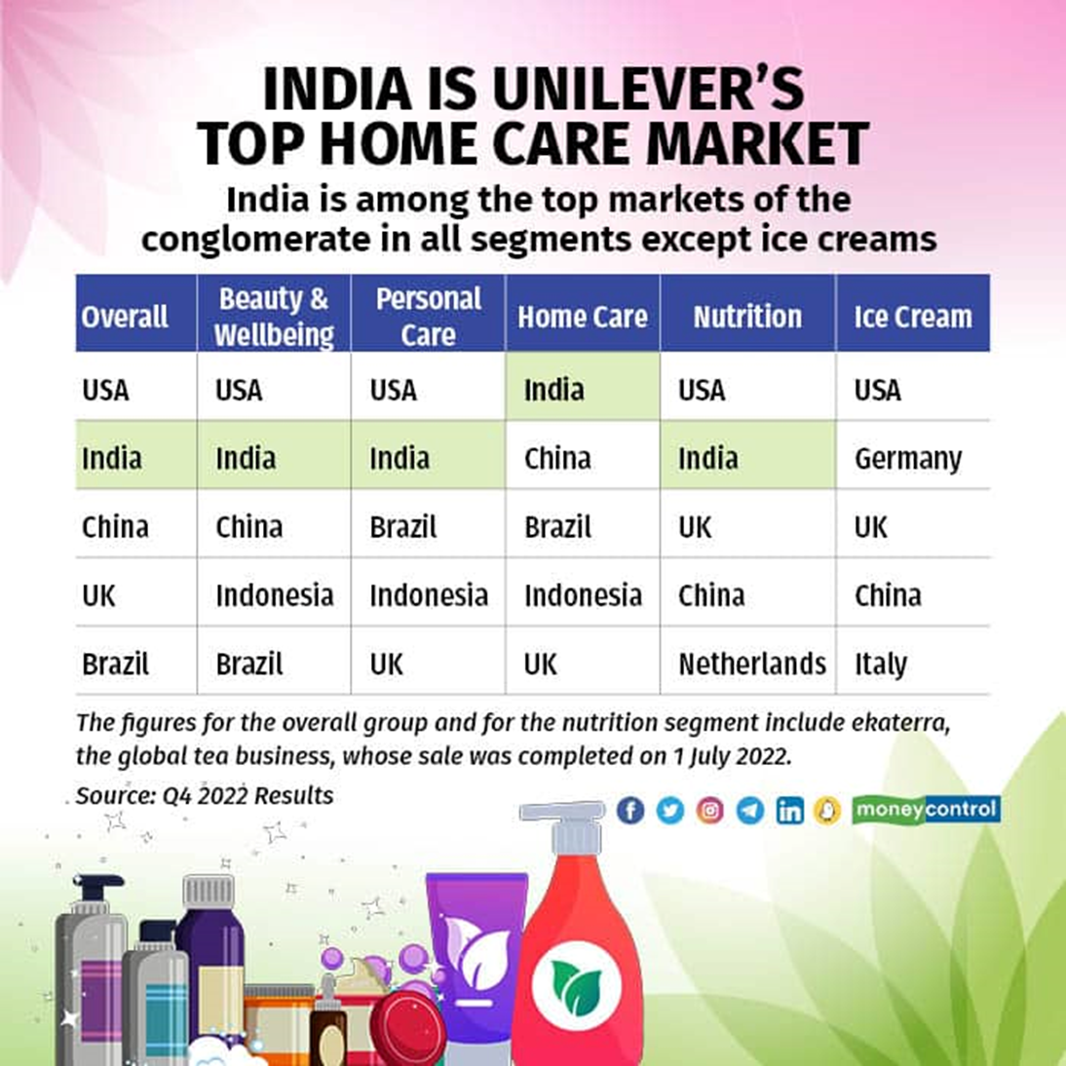

Slide 35
HUL Product Mix-Width
Product mix/ assortment- Is the set of all products and items a particular seller offers for sale. A company’s product mix has certain
Width- How many different product lines
Length- The total number of items in the mix
Depth- How many variants are offered of each product
Consistency- How closely related the product lines are.
Product mix dimensions permit the company to expand its business in following ways. It can add new product lines. It can lengthen each product line It can add more product variants Line stretching, Pruning
 | Personal Wash | Laundry | Skin Care | Hair care | Oral Care | Deo | Ayurvedic | Cosmetics | Tea | Coffee | Foods | Icecream
Product Line Length | Lux | Surf Excel | F& Lovely | Sunsilk | Pepsodent | Axe | Ayush | Lakme | Brooke Bond | Bru | Kissan | Kwality Walls
 | Liril | Rin | Ponds | Clinic | CloseUp | Rexona |  |  | Lipton |  | Knorr
 | Lifebuoy | Wheel | Vaseline |  |  |  |  |  |  |  | Annapurna
 | Dove
 | Pears
 | Hamam
 | Breeze
 | Rexona

Slide 36

Is this entity a brand?
Yes/ NO –Justify

Slide 37
Brand
Need fulfillment
Clear Identity
Tangibles and Intangibles
Is it different
Create Value

Slide 38
Brand Virat
Need fulfillment- Winning, Achievement, Entertainment,
Clear Identity- Successful Captain, Active, Anushka
Tangibles (Batting Records, Physical Fitness, Beard) and Intangibles- Proud, Inspires
Different- Aggression, Stand-Cola, Cool- Dhoni, Patient Hitman Rohit
Create Value- BCCI, Fans, Viewers, IPL franchise, Endorsements

Slide 39
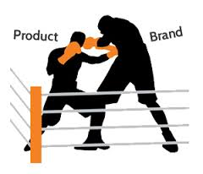
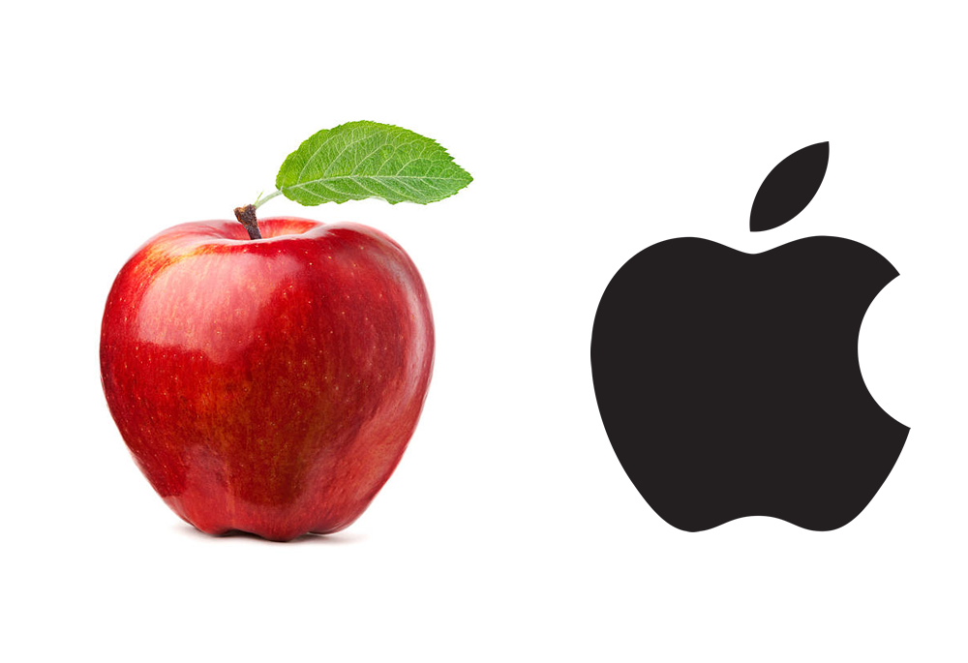


Slide 40
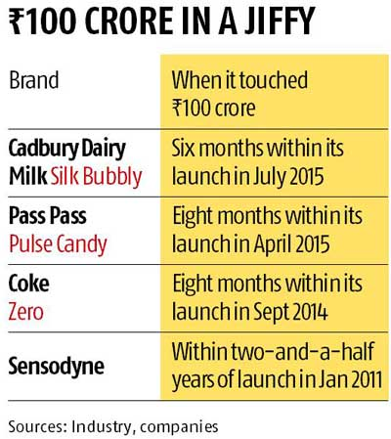
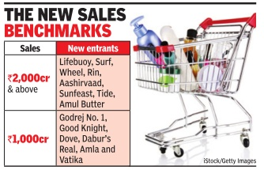
Rs 100-crore mark in a short span
Surf Excel becomes first Indian home care brand to top $1 bn annual Sales, With a total sales of Rs 8,200 crore, it also became HUL's first brand to reach the milestone

Slide 41
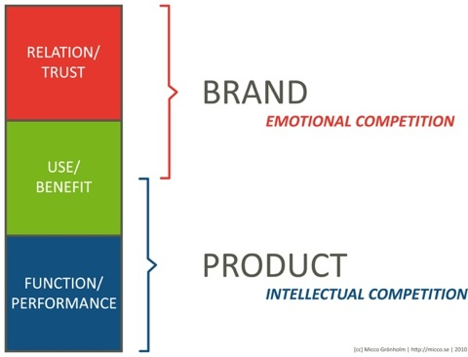
Brand
Personality
Symbols
Relationships
Emotional benefits
Self expressive benefits
User Imagery
Country of Origin
Product
Scope
Uses
Attributes
Quality
Titan
Citizen

Slide 42



Endow power- brand
A name, term, sign, symbol or design or a combination of them intended to identify the goods or services of one seller or group of sellers and to differentiate them from those of competitors.

Slide 43
Brand Ranking

Slide 44
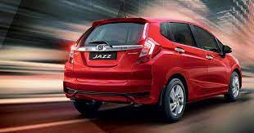
The previous Jazz had a price tag of Rs 6.98 lakh.
After an encouraging start in 2009, volumes started dipping from the second year. In the second year, volumes dipped 36 per cent and again 15 per cent in the following year. Saddled with excess stock, Honda slashed price by Rs 1.62 lakh and eventually pulled out the car.
Honda re-launched the Jazz - Rs 5.31 lakh.
Jazz competes with the likes of Maruti Suzuki Swift and Elitei20 of Hyundai.
The launch takes place more than two years after the company stopped production of the car in March 2013.
Greater localisation enables the company to price the vehicle more aggressively.

Slide 45
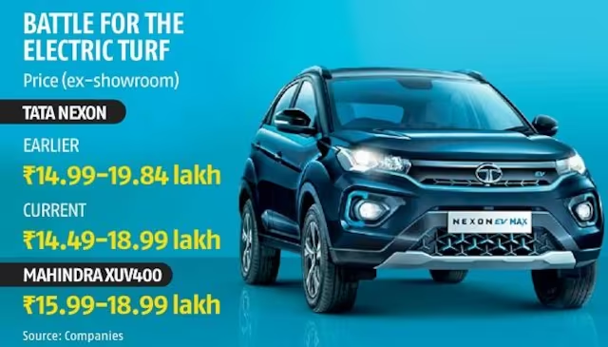
Tata Motors has decided to significantly slash the prices of its popular Nexon EV by Rs 31,000-85,000 amid intensifying competition.
Mahindra & Mahindra (M&M) launched its much-awaited compact electric sport utility vehicle — the XUV400 — at a competitive price point.
At Rs 18.99 lakh, the Nexon’s top variant is equivalent to M&M’s XUV400’s top trim. Tata Motors has also reduced the price of its low-end variant by Rs 50,000 to Rs 14.49 lakh (ex-showroom), making it cheaper by Rs 1.5 lakh than the XUV400’s low-end variant.

Slide 46
Skimming Penetration Price Non Price

Slide 47
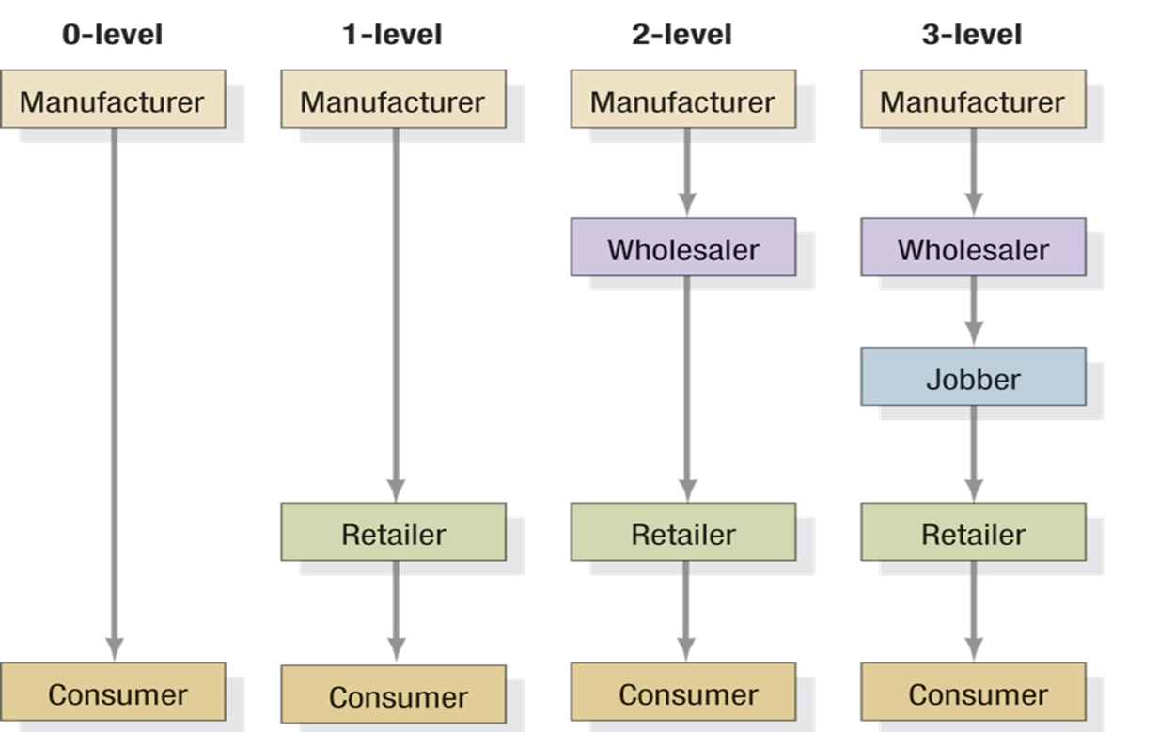
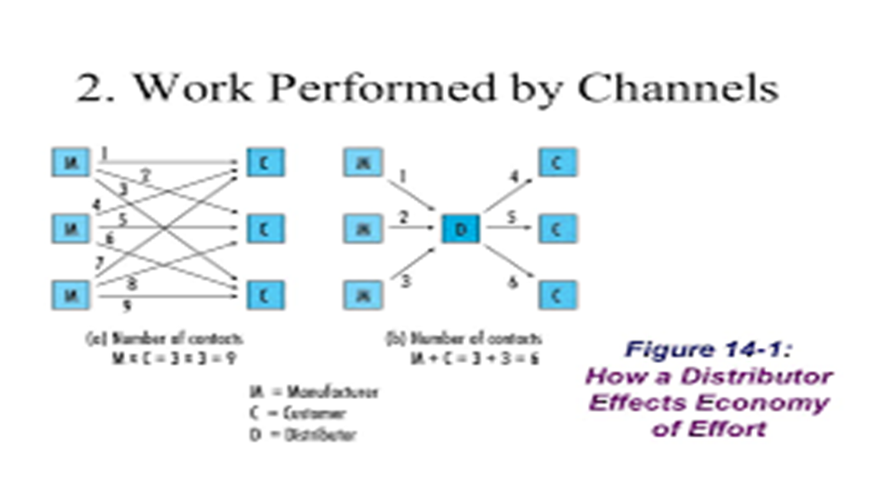
Distribution channel A distribution channel is a set of interdependent organizations that help make a product or service available for use or consumption by the consumer or business user.
Consumer Marketing Channels

Slide 48
Three strategies Intensive-Convenience products- as many outlets as possible Selective -Durables, more than one but fewer than all Exclusive-Luxury Limited number

Slide 49
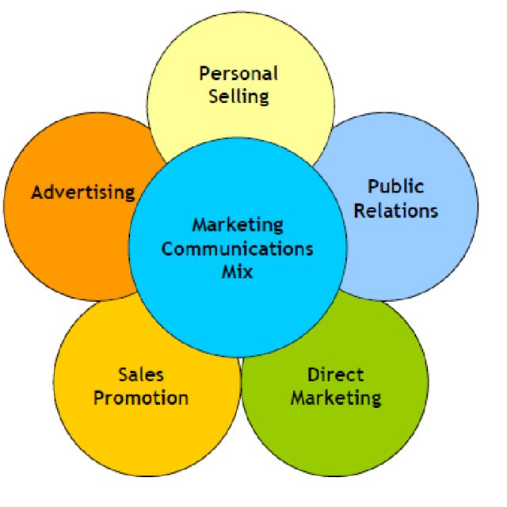

Slide 50
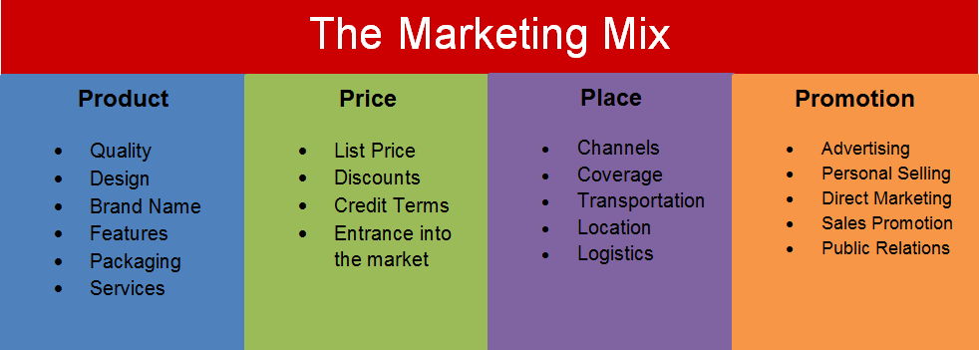

Slide 51
Brave and Beautiful

Slide 52
Thank You

